Slide 1
Rapid City Fire Department
Prepare Prevent Protect

Slide 3
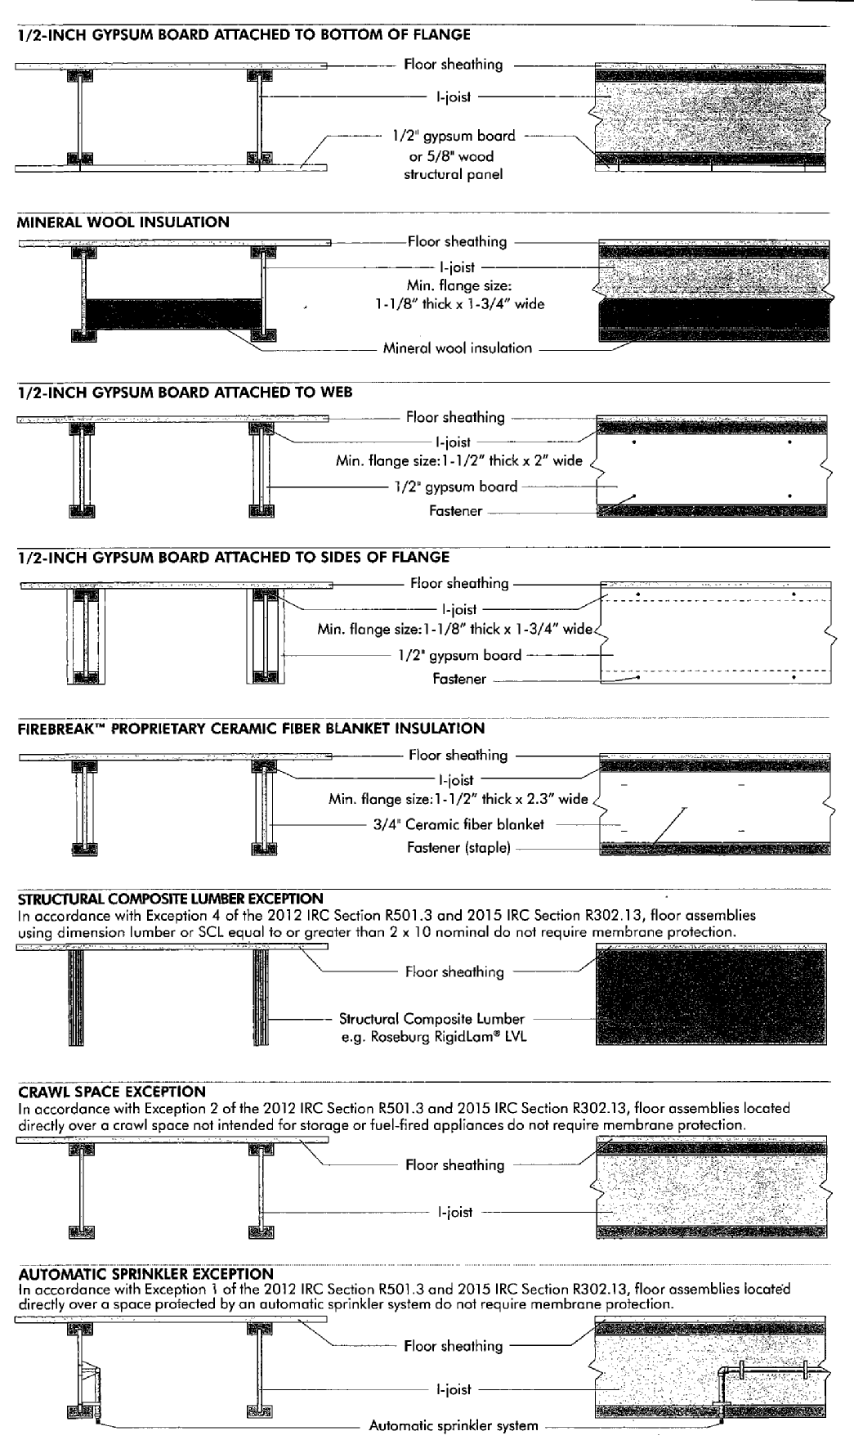

Slide 4
Modern Construction and Fire
Modern Light weight Construction
( High Performance )
Legacy Construction
Fire Effects on the structure
Residential Fire Environment

Slide 5
LIGHTWEIGHT CONSTRUCTION
DEFINITION:
Lightweight construction does not derive its strength from size. Its strength is obtained from multiple members that are in compression and tension.
Additionally, the strength of the individual structural member is dependent on the sum total of the other members; thus, if one member fails, other members may fail.

Slide 6
Residential construction:
Legacy Construction
Full size lumber ( Mass)
Spacing
Nails, bolts, heavy screws
Rafters and Timber beams
Lightweight Construction
Small sized components
Minimal amount of safety designed into the system
Gussets and Glue
Trusses and Engineered Beams
Composite/Vinyl doors and windows
Notes:
We have all seen the constant reminders Chief Kobes and the education division sends out on the failures and just hard to imagine techniques being used. ( finger jointed wood, long spans, etc. )

Slide 7
Lightweight Construction by the Numbers
Greater than 60% of Roof / floor systems since 90’s
Underwriter Laboratories Floor System Observations
Subfloor temp to 200 f LW: 5:30 Legacy 12:00
Surface Temp at 5 Minutes: LW- 85 f Legacy 73 f
Visible Smoke: LW- 2:30 Legacy 13:00
Visible Flames: LW- 5:50 Legacy 17:50
Average time to Structural Failure
Legacy Construction 18 minutes
Lightweight Construction 6 minutes

Slide 8
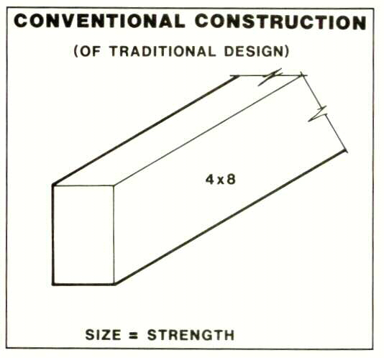
LIGHTWEIGHT CONSTRUCTION

Slide 9
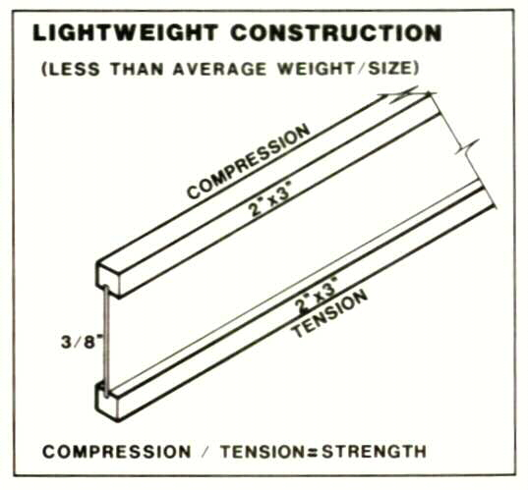
LIGHTWEIGHT CONSTRUCTION

Slide 10
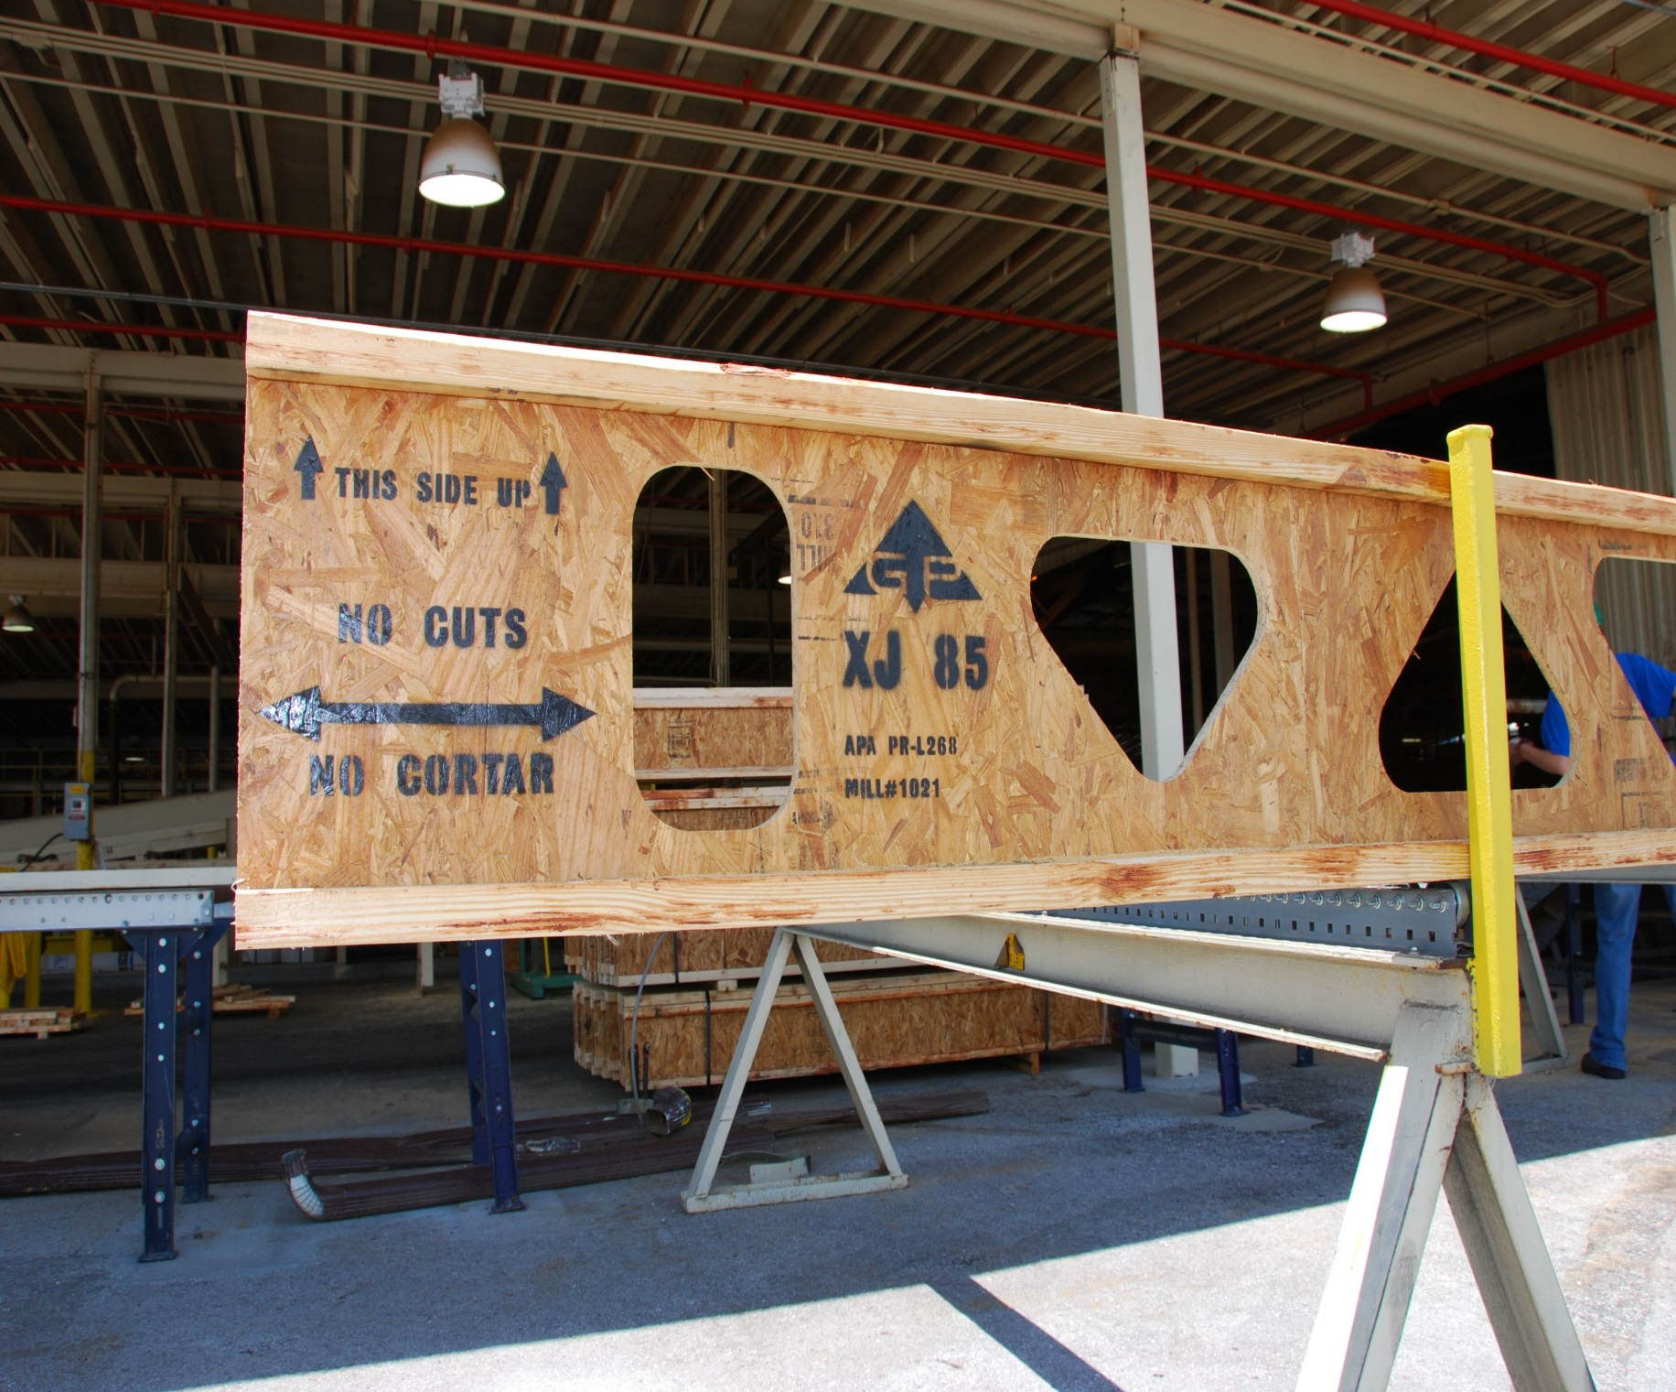

Slide 11
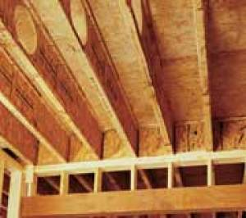

Slide 12
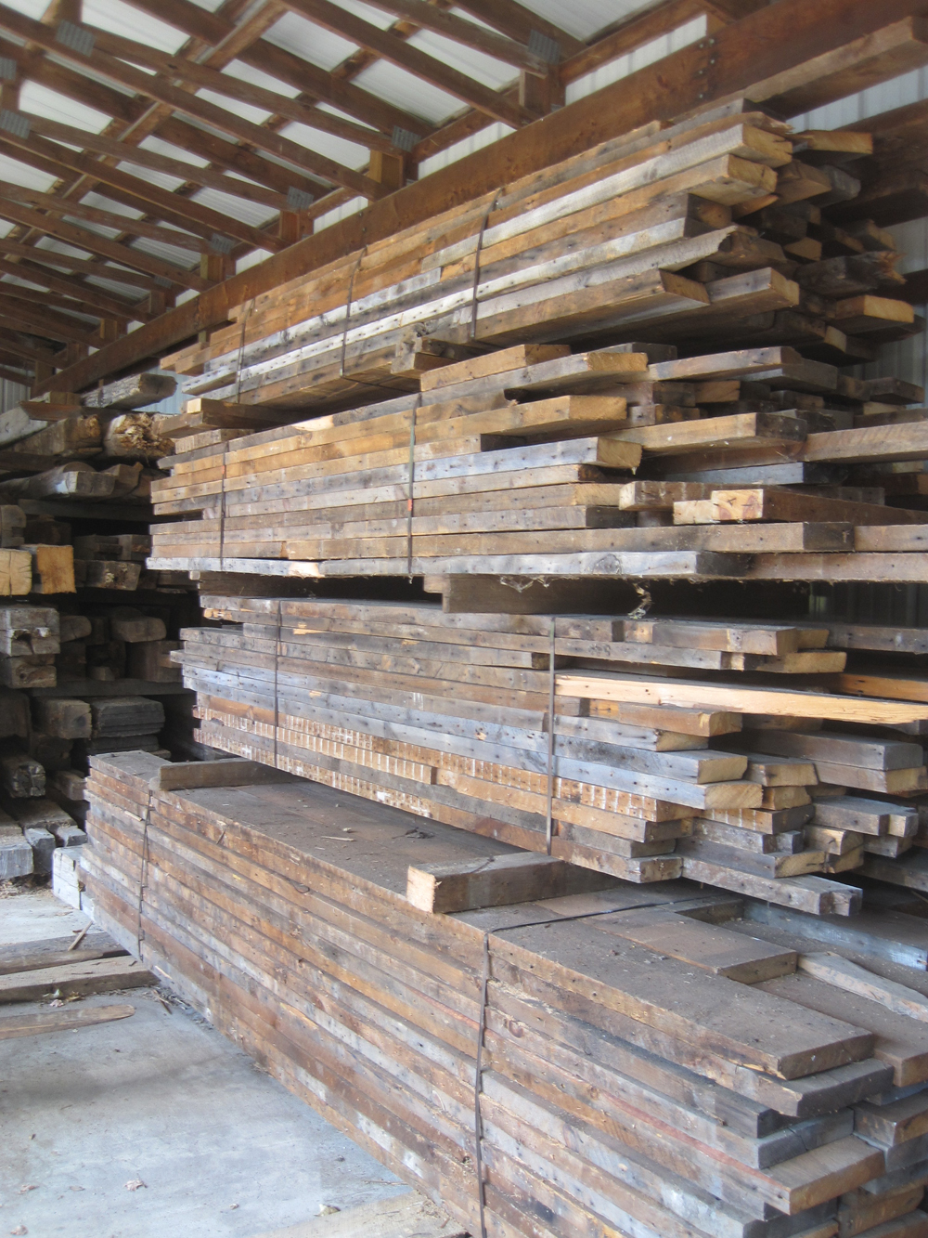

Slide 13
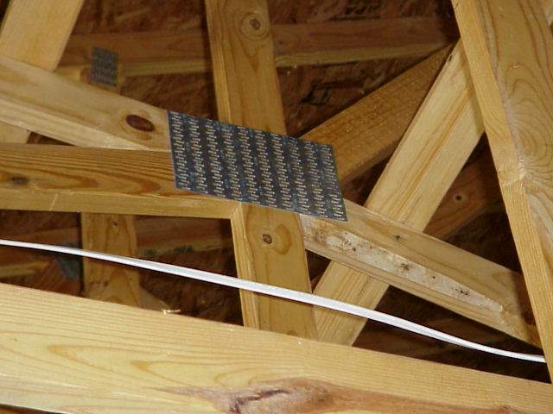
LIGHTWEIGHT CONSTRUCTION

Slide 14
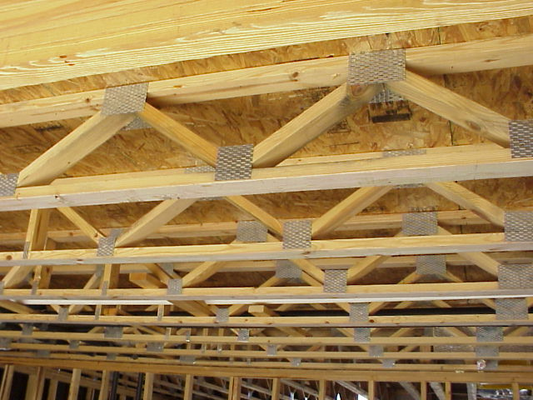
LIGHTWEIGHT CONSTRUCTION

Slide 15
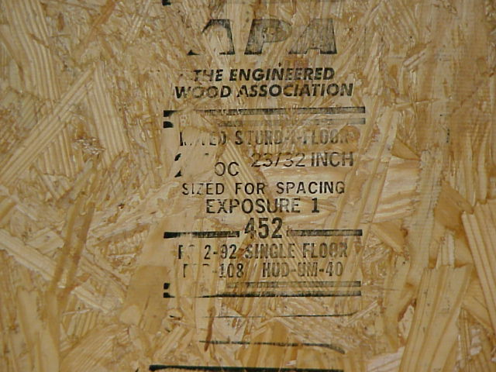
LIGHTWEIGHT CONSTRUCTION

Slide 16
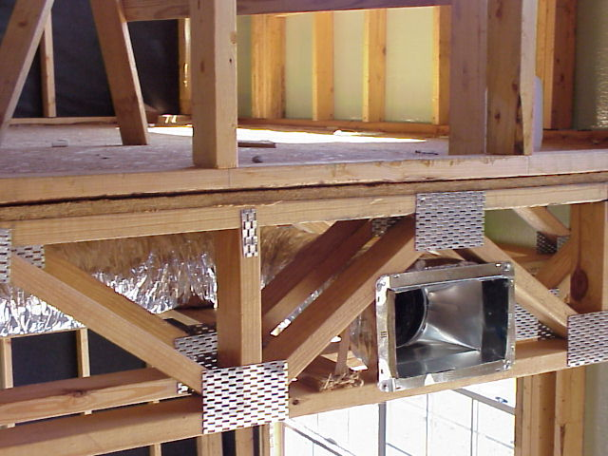
LIGHTWEIGHT CONSTRUCTION

Slide 17
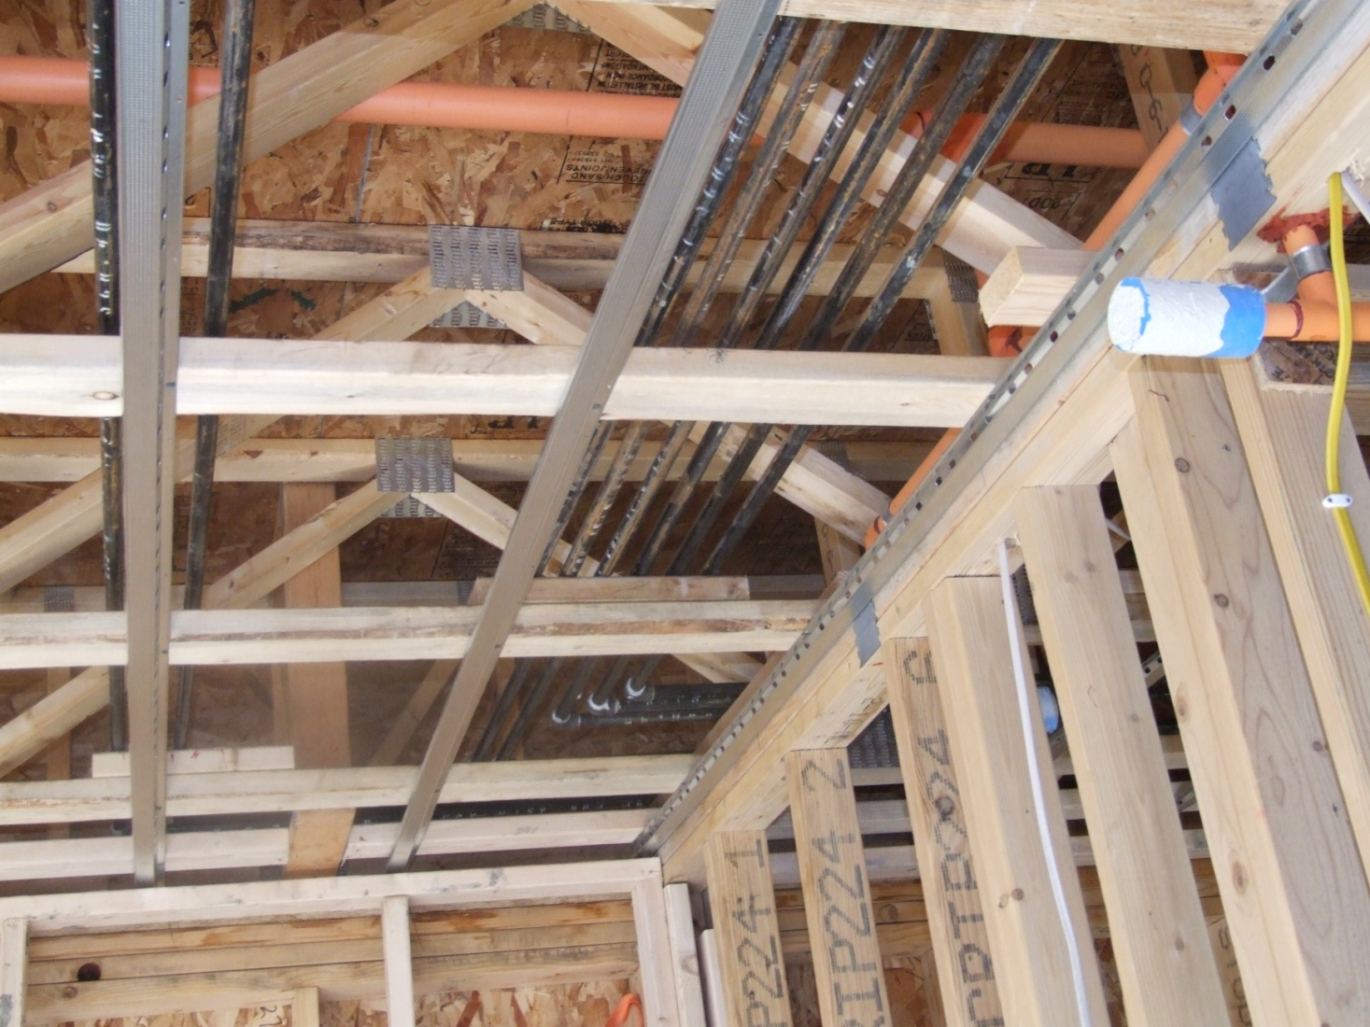
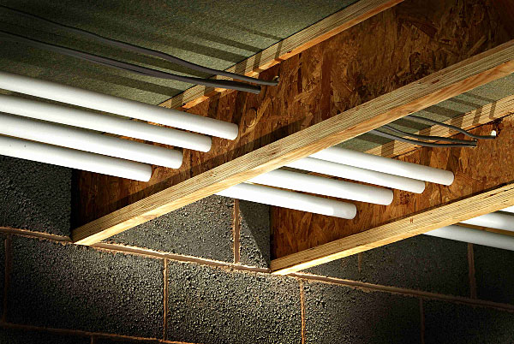
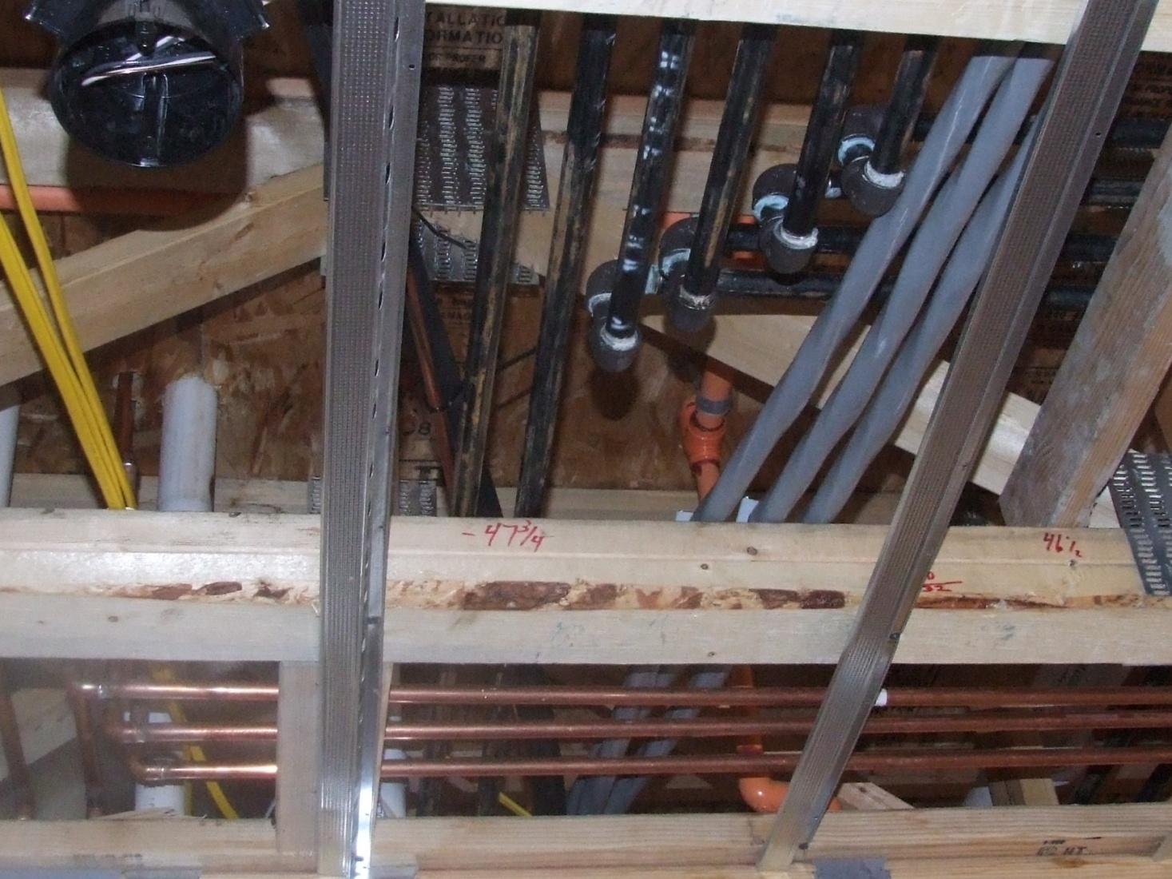
Potential Dangerous Situations: 2010 Lightweight Construction
Notes:
We all hopefully know the dangers of the building techniques that are in approximately 70% of the construction in the U.S.
These are pictures from some of the recent construction in town.

Slide 18
Residential Fire Environment Modern Furnishings
Synthetic Materials such as Polyurethane
Increased Damage
Rapid Fire Development
Increased Smoke Development
Time it takes for a room to burst into flame
Legacy Furnishings 4 minutes 25 seconds
Modern Furnishings 1 minute 50 seconds
Todays Furnishings… contribute to fires burning bigger and faster than ever before.

Slide 19
Lightweight (HP)Construction and Modern Furnishings
It is not Light Weight (High Performance) construction. The concern is what happens when lightweight construction meets fire.
I like to compare it to a modern High performance automobile, operating in conditions for which it was not intended..

Slide 20
The Problem
Occupant Escape
Structural Collapse
Reduced from an avg. of 5 minutes to 2 minutes from the Start of the incident.
Highlights the importance of Smoke detection, Fire sprinkler protection, and an Escape Plan
6 to 8 Minutes until the structure is compromised preventing Fire Department entry

Slide 21
Time vs. Products of Combustion

Slide 22
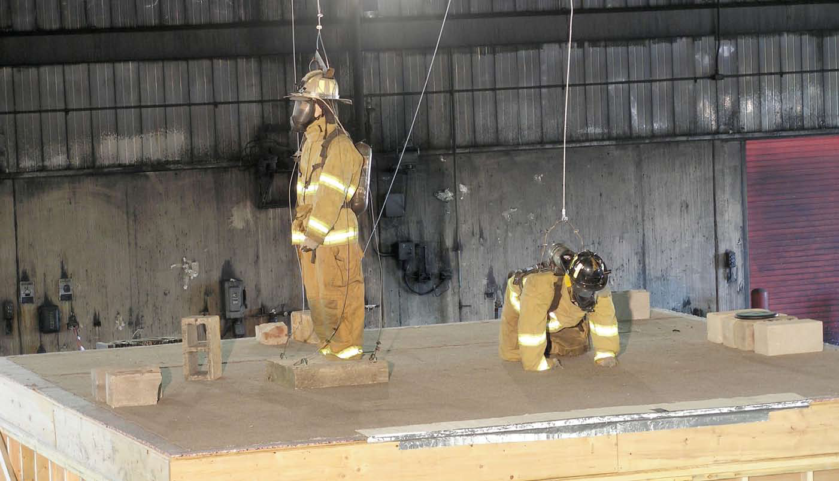
Notes:
This is a picture of a study TYCO and others did.
I believe it was a 275# and 300# dummies used. Concrete blocks represent weight of normal objects around the room.
We use TIC’s as thermal detection sometimes instead of thermal imaging. This might be ok, but only another tool.
TIC in this instance registered at 82 degrees at the floor for most of the scenario. At 8 min. 143 degrees. Floor collapsed at 8:49 seconds. No signs of failure. You can find the whole report on the web.
In this case not much weight was above you. What about concrete roofs 900 lbs. a square and up vs. what 325# for asphalt shingles. Granit and concrets counter tops. China Hutchs. Gun Cases. YOU GET IT, I HOPE!

Slide 23
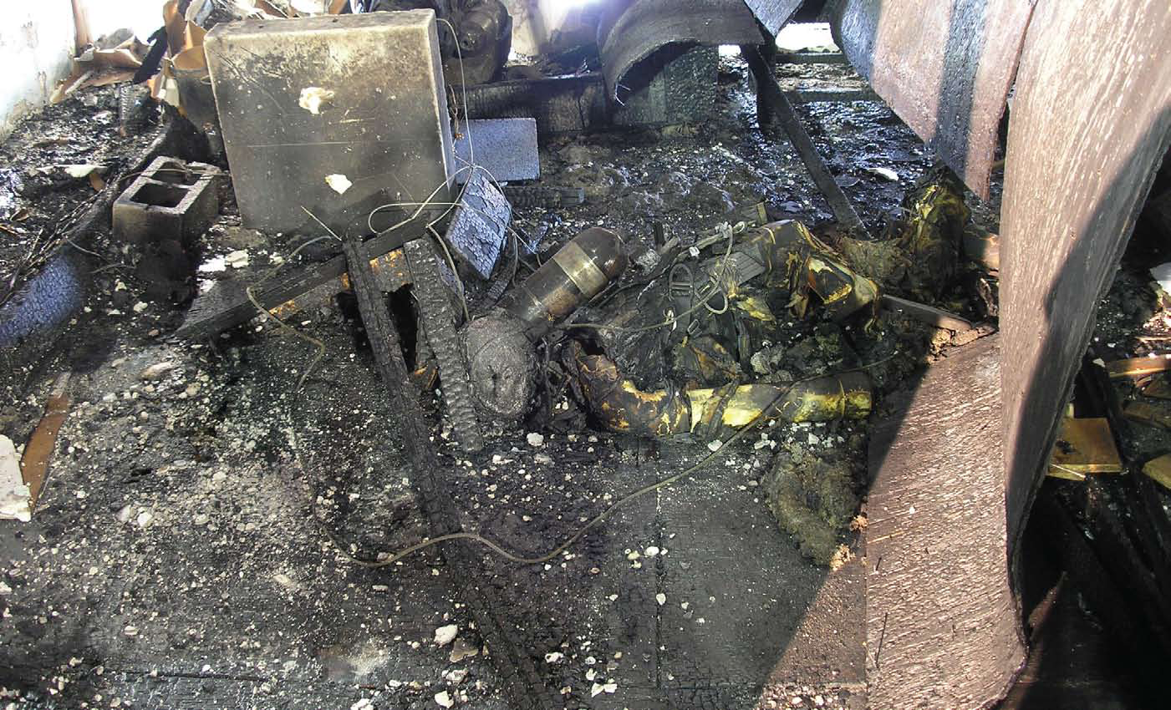

Slide 24
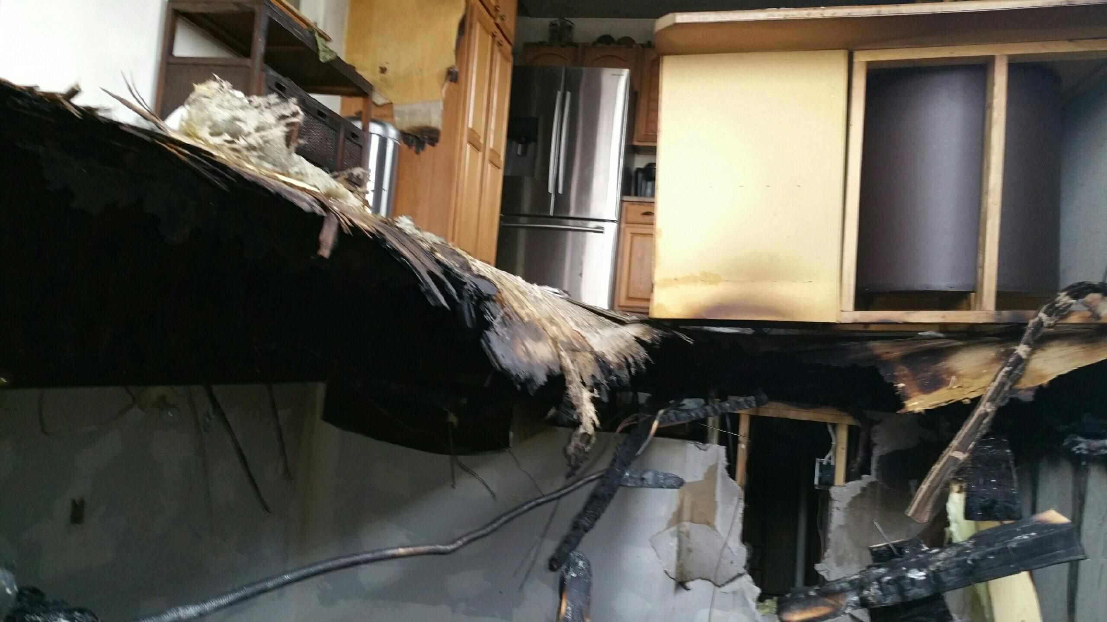
http://youtu.be/aDNPhq5ggoE

Slide 25
Questions
?

Slide 26
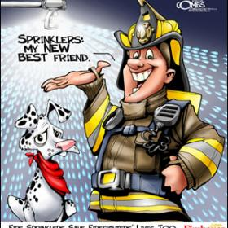
Notes:
Ok, so there you have it!
Touch on current Legislation going on!
Explain what this could do! WUIC, building code trade offs, etc.
YOU think trailers are dangerous at least most of the don’t have kids sleeping in the basements.

Slide 27
Rapid City Fire Department
Prepare Prevent Protect

