Slide 1
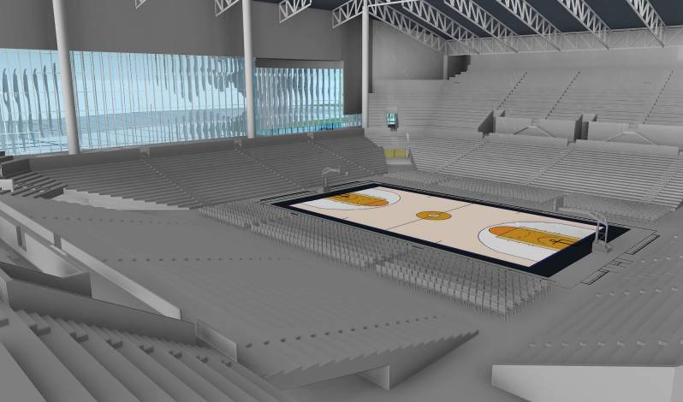
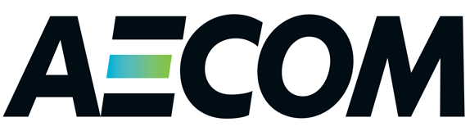
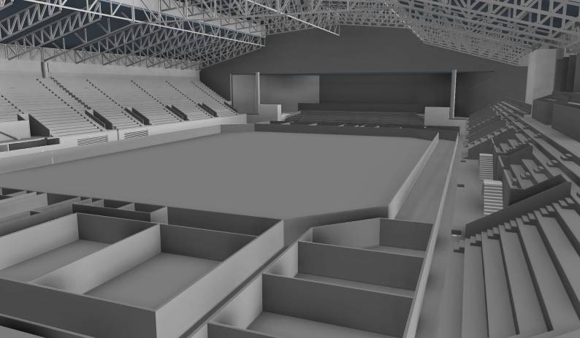
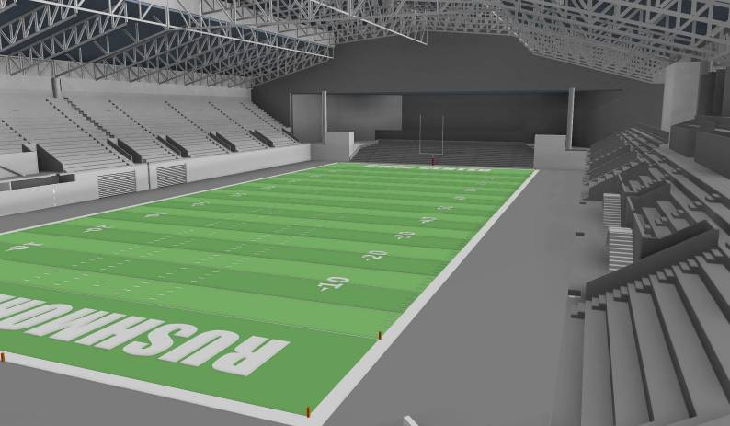
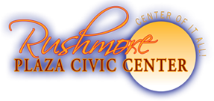
Blue Concept Feasibility Study Presentation
^{November 3, 2014}

Slide 2
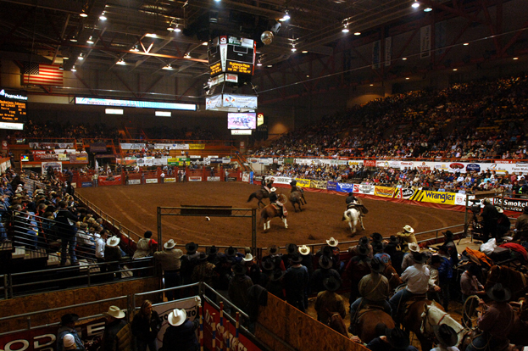
Introduction
The Local Market
The RPCC and the Competitive Environment
Projections of Future Operations

Slide 3
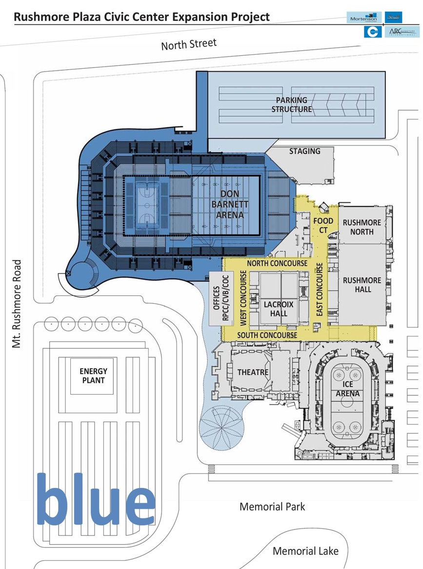
Introduction
2012: AECOM was engaged to perform an economic impact analysis for a planned new arena at the RPCC
2014: AECOM engaged to perform a feasibility study/business plan for future operations of the RPCC under the “Blue” concept
  Differences between the two analyses
  Differences in the two concepts analyzed
David Stone, AECOM Economics
  Performed both studies
  Expertise in sports, entertainment, and convention facilities
  Experience includes Denny Sanford PREMIER Center and Swiftel Center

Slide 4
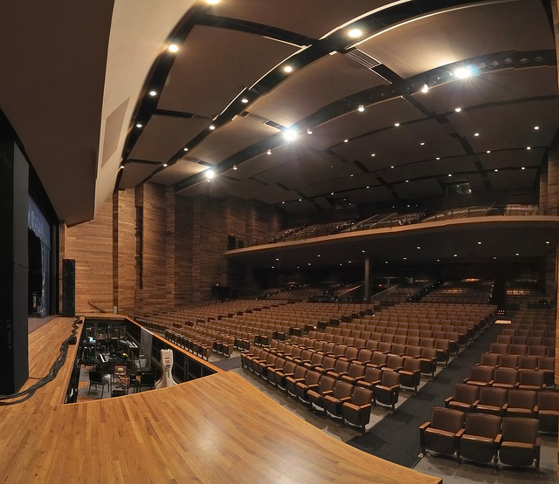
Introduction
The Local Market
The RPCC and the Competitive Environment
Projections of Future Operations

Slide 5
The Local Market
Rapid City is technically a relatively small market but benefits from strong tourism and status as a regional draw well beyond the defined metropolitan area (Pennington, Custer, and Meade counties)
  City population: 70,000
  Metro population: 140,000
  3 million tourists
  Past RPCC ticket sales from a wide geographic area
Demographics: relatively young population, relatively low income levels, low unemployment
The area is benefitting from proximity to oil basins

Slide 6
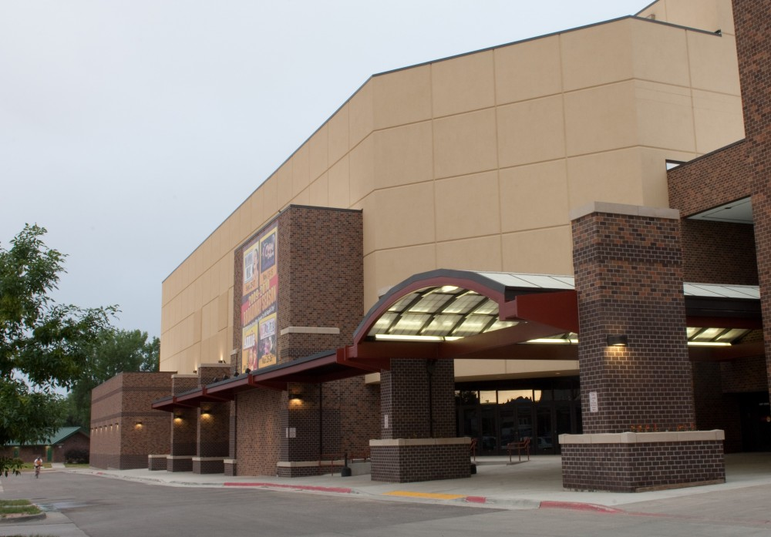
Introduction
The Local Market
The RPCC and the Competitive Environment
Projections of Future Operations

Slide 7
Key Personnel
The RPCC and Competitive Market
Past RPCC Operations (not including certain events/uses):

Slide 8
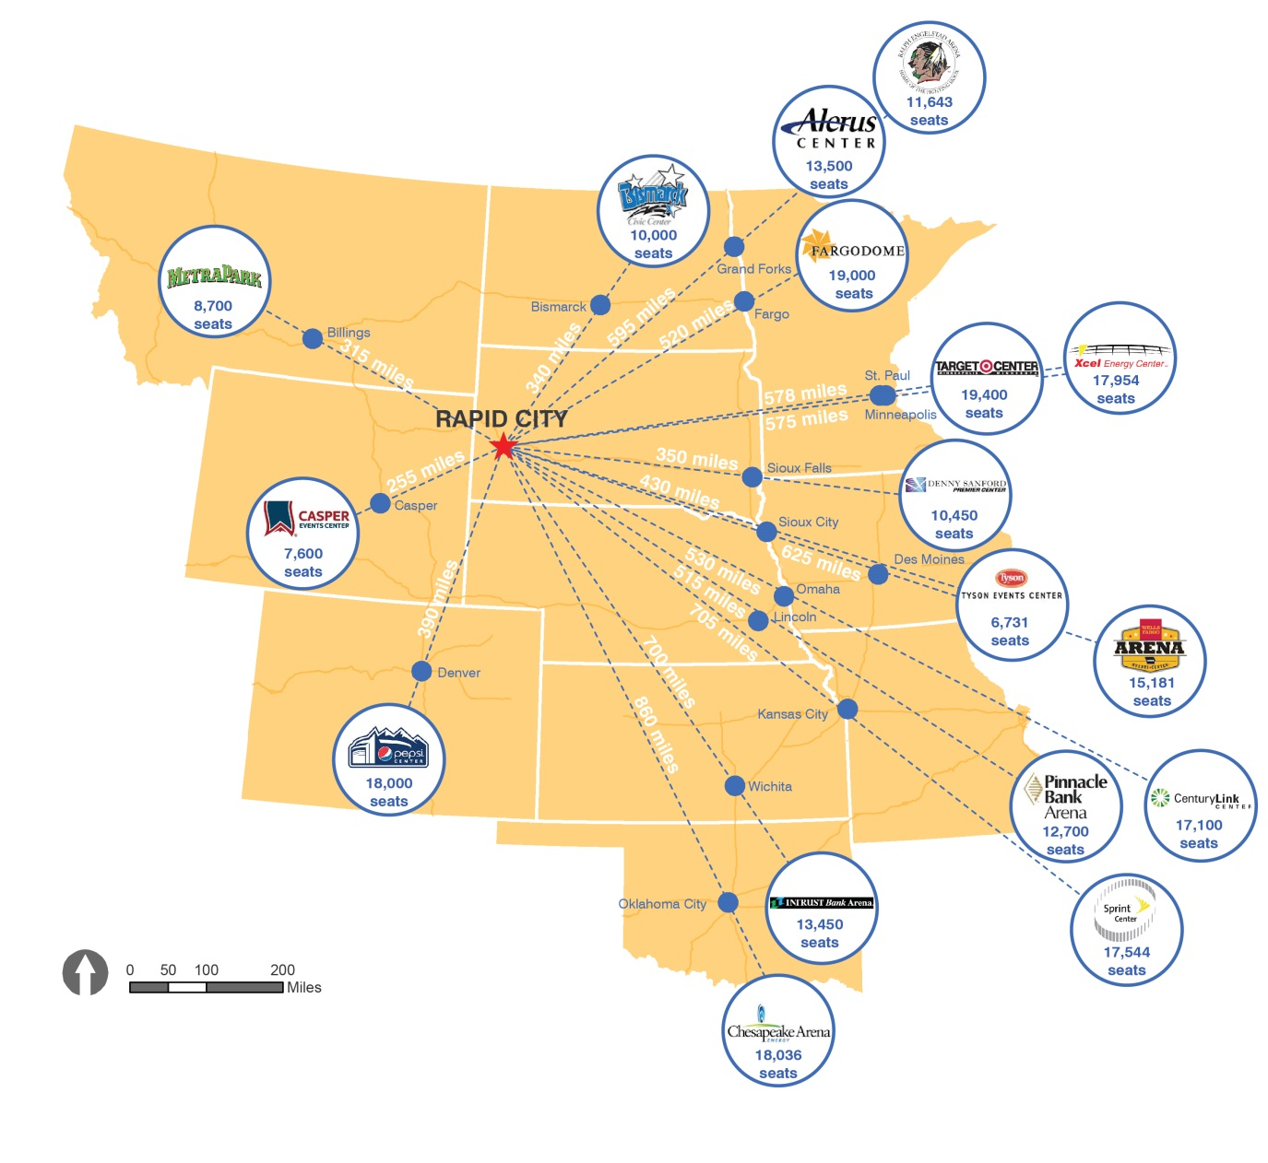
Key Personnel
The RPCC and Competitive Market
Regional Arena Market
  More complementary than competitive
  Bringing new and bigger acts to the region
  However, not all tours will stop in every market on every tour

Slide 9
Key Personnel
The RPCC and Competitive Market
Feedback from RPCC Users
  BHSS
    Generally limited by RPCC facilities
    Barnett Arena floor is too small
    Blue concept would add needed space and allow Rodeo to bring all events on-site; additional arena seating could also lead to increased prize money and better competition
  LNI – could also use additional space and would be able to bring all events on-site
  Concerts – new arena could host shows that Barnett Arena cannot accommodate
  Other Events that Could Benefit from Blue Concept
    SDHSAA events
    State Dart Tournament
    Flat shows
    Sporting events
    Family shows

Slide 10
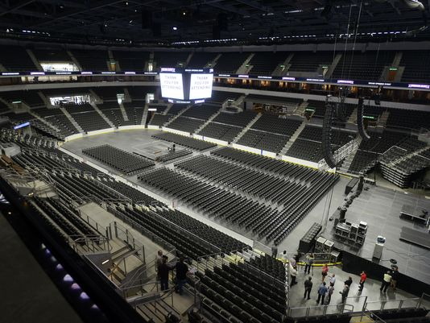
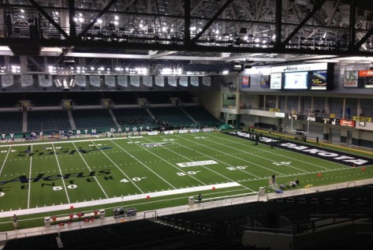
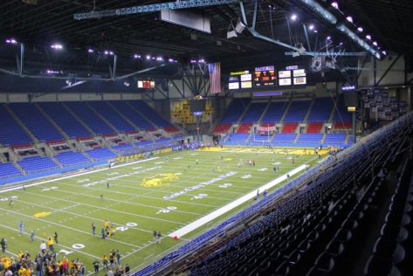
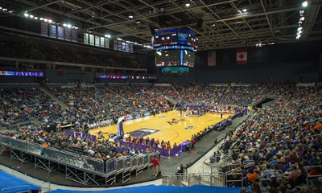
Key Personnel
The RPCC and Competitive Market
Comparable Facilities
  Denny Sanford PREMIER Center, Sioux Falls
  Alerus Center, Grand Forks, ND
  Fargodome, Fargo, ND
  Ford Center, Evansville, IN
Results:
  Ability to attract new and larger events
  Ability to generate new revenues
  Ability to be profitable

Slide 11
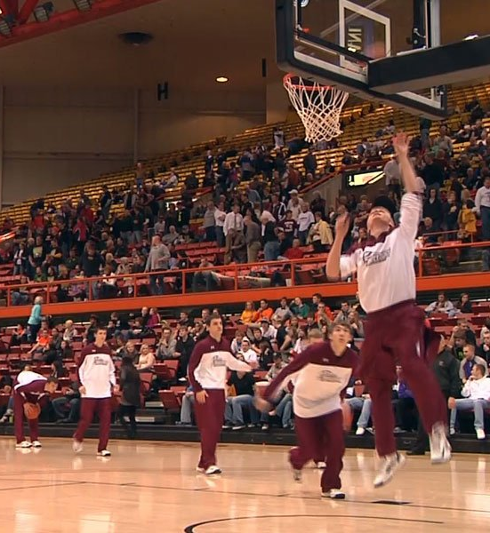
Introduction
The Local Market
The RPCC and the Competitive Environment
Projections of Future Operations

Slide 12
Projections of Future Operations
Blue Concept: for first 10 years once the new arena opens
Assumed construction schedule:
  July 2017 – new arena opens, Barnett Arena becomes unavailable
  July 2018 – renovated Barnett Arena is completed
  2019 – first full year of all new/renovated facilities
Based on factors including past RPCC operations, comparable facilities, and staff input
Forecasts of event types and facilities that are not affected by new/improved arenas are not changed from past levels

Slide 13
Projections of Future Operations
Past and Future Events
  Does not include practices, rehearsals, and move days

Slide 14
Projections of Future Operations
Past and Total Paid Attendance
  Does not include practices, rehearsals, and move days

Slide 15
Projections of Future Operations
Past and Future Revenues and Expenses

Slide 16
Projections of Future Operations

Slide 17
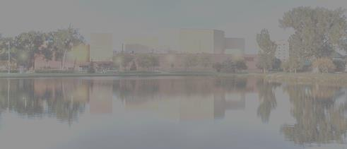
Thank You

